Slide 1
How do Cat Models Work?
TIGERRISK PARTNERS

Slide 2
Key historical catastrophes
Hurricane
Wildfire
Andrew (1992)
Katrina / Rita / Wilma (2005)
Sandy (2012)
Harvey / Irma / Maria (2017)
Michael (2018)
2020 and 2021 Cat Years
Cedar (2003)
Tennessee (2016)
Northern California (2017)
Camp (2018)
Woolsey (2018)
OR/WA (2020)
Earthquake
Severe Storm
New Madrid (1811 – 1812)
San Francisco + Fire (1906)
Northridge (1994)
Virginia (2011)
Tornado Outbreak (2011)
Joplin (2011)
MidWest Derecho (2020)
Texas Freeze (2021)

Slide 3







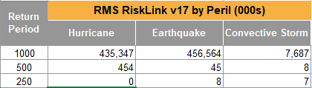
What is cat modeling?
Cat modeling is necessary to estimate financial risk from major catastrophes where actuarial techniques do not apply
Reinsurance structuring and pricing
Client portfolio monitoring and optimization
Catastrophe response
Other Tiger tools (TigerEye, TigerCQ)
Cat models – different “Perils”
Event Generation
Hazard
Vulnerability/Damage
Financial
Modeled Loss Results
Loss files
Loss statistics
EP loss, AAL loss, etc
Exposure Data
Geographic information
Policy information
Risk Characteristics
Rate filing requests

Slide 4
Common misconceptions of cat models
A cat model tells me what this year’s hurricane season will be like
A cat model tells me the range of possible scenarios and their associated likelihoods
A cat model includes every possible outcome
Cat models attempt to realistically incorporate the range of possibilities, but can never capture all
Cat models include all aspects of loss
Cat models focus particularly on structural damages and any associated time element loss

Slide 5





Models we license
AIR
RMS
RQE
Katrisk
We do not license KCC

Slide 6
Cat perils and how they cause damage
Hurricane
Wind
Storm Surge
Precipitation Flooding
Earthquake
Ground shaking
Landslide / Liquefaction
Sprinkler Leakage
Fire Following
Severe Convective Storm (Thunderstorm)
Hail
Wind
Tornado
Winter Storm
Wind
Freeze
Snow load
Wildfire
Fire
Smoke
Flood
Inundation (fluvial and pluvial)
Euro Wind Storm
Wind
Storm Surge

Slide 7









Modules of cat models
Exposure
Geocoding
Building characteristics
Aggregate vs location data
Hazard
Simulating the damaging factor
Combining multiple damage causes
Vulnerability
Damageability of structures
Coverages
Financial
Ground up
Gross
Reinsurance

Slide 8
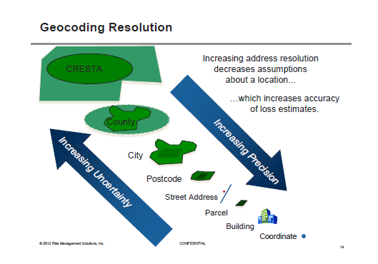
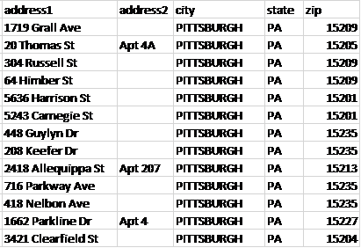
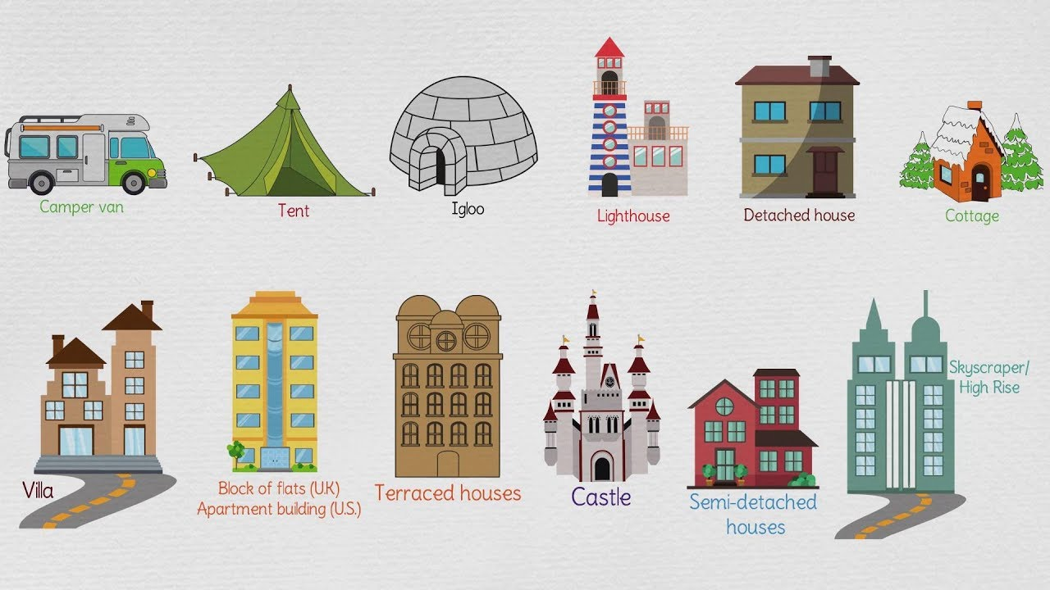
Exposure – where is it and what is it?
We get exposure data that we attempt to assign to the most accurate geo-coordinates
Address data isn’t perfect – sometimes addresses are only able to be resolved at the postal code or county level
Where?
After we know where a property is located, we must assign basic property attributes such as the type of structure / what it is used for (occupancy) and how it was constructed.
These attributes (and more) effect how a property responds to the damage driver from an event.

Slide 9
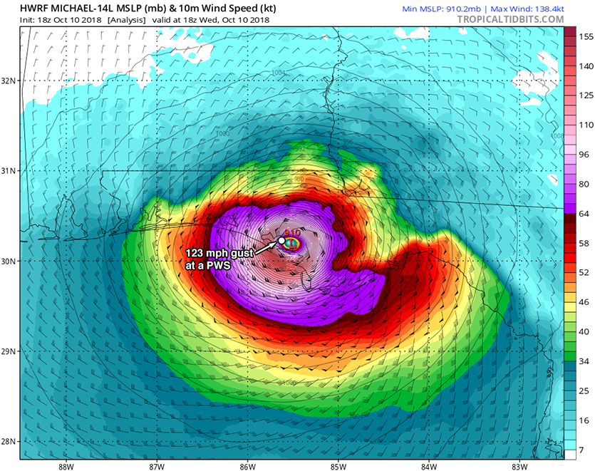
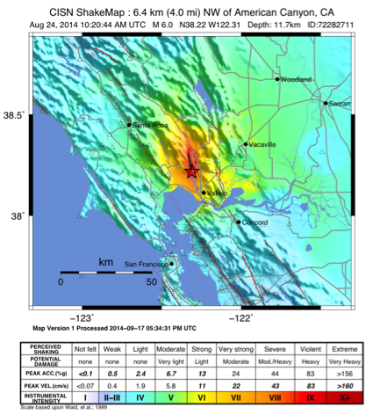
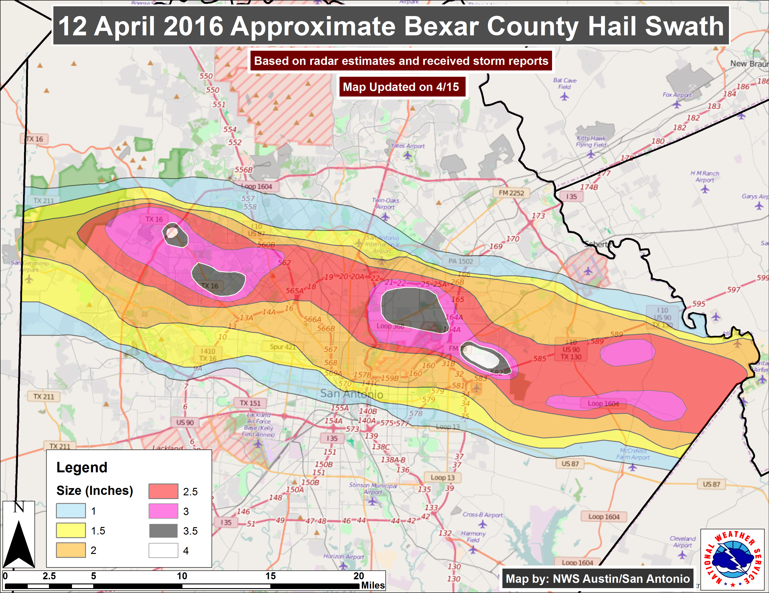
Hazard – simulating an event’s intensity
Depending on wind conditions, hail can start to do damage at a diameter of 0.75”. Roofs and glass surfaces are most vulnerable to hail damage
Colors represent wind speeds from a Hurricane. As windspeeds increase, the amount of damage to a structure increases.
Colors represent the intensity of ground shaking. Buildings experience more damage as intensity increases
Notes:
An event’s intensity needs to be simulated to translate that intensity to structural damage. For each peril there is a different type of hazard simulated. Wind speed and duration for hurricane, ground shaking intensity in peak ground acceleration, or modified mercali intensity for earthquake, hail size, etc. In the end, the models produce a hazard footprint for each event that is independent of the exposure. There are also underlying hazard data values incorporated into models that affect site level intensity such as elevation (flood), soil type (EQ), fuel type (WF)

Slide 10
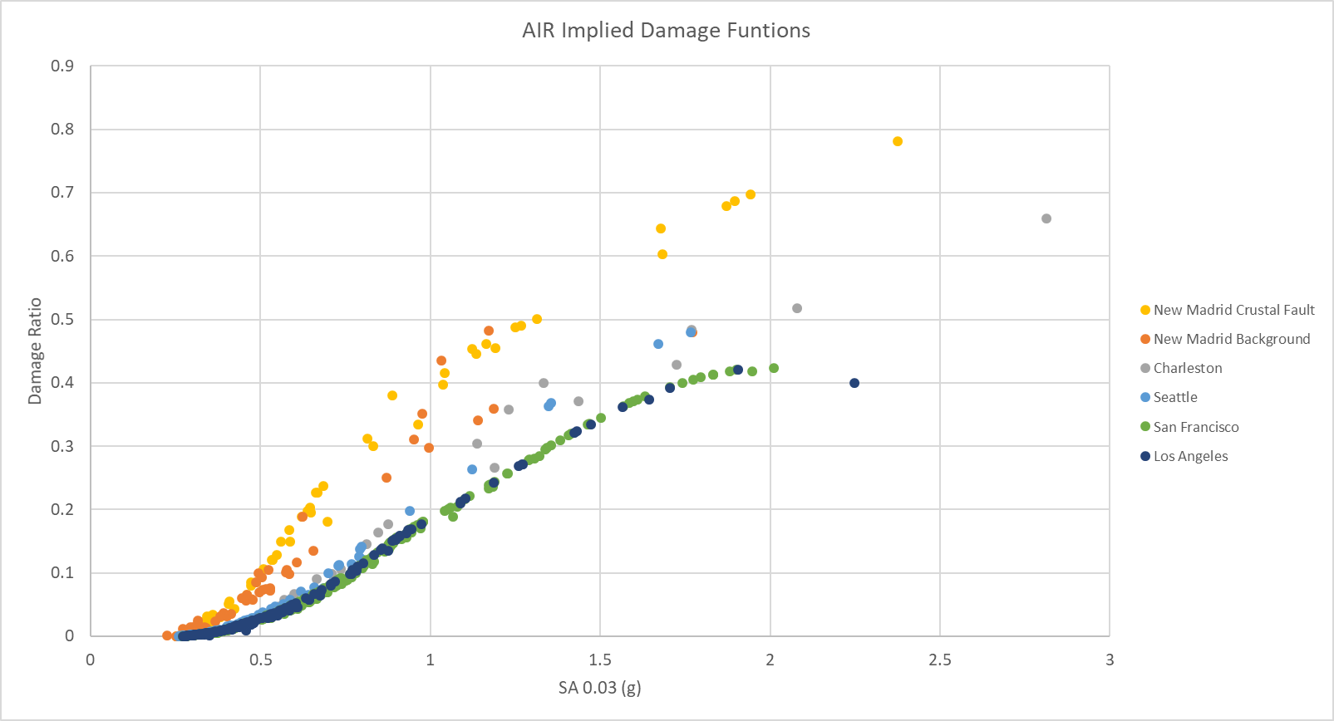
Vulnerability: converting hazard intensity to structural damage
Location and event specific regardless of exposure
Hazard
Building Codes
Building Characteristics
Mitigation Factors +
Vulnerability
A certain level of resilience is expected when building codes are enforced. I.e. buildings on the coast can withstand higher windspeeds.
Building type, year built and region all play a role

Slide 11
Financial module
The models simulate loss to:
Buildings
Usually the primary damage driver (i.e. windspeed or ground shaking)
Other structures
Treated same as buildings
Contents
Damage usually depends on building damage
Time Element
A function of building damage
Those losses are combined to create a “Ground up” loss (in a world with no insurance)
Insurance terms (deductibles and limits) are applied to ground up loss to calculate “Gross” loss
Reinsurance terms are applied to the gross loss to calculate “Net” loss

Slide 12
How it’s done
Events
Simulate a single event – generate losses based on exposure, hazard, and vulnerability
Years
Group / distribute events into simulated years
Catalogs
Multiple years
Key differences across platforms
Catalog Structure
AIR 10k catalog
RMS event rates
Catalog offering
AIR LT and WSST
RMS LT and MT
Catalogs
Years
Events

Slide 13
Model output: return period misinterpretation & misuse
$123 Million is a 1 in a 100 year hurricane loss for Company X
INCORRECT: $123 Million is the probable maximum loss in the next 100 calendar years
CORRECT: There is a 1% annual probability of a hurricane loss of $123M or greater for Company X
PML means different things to different people and creates confusion
“It’s the worst case scenario”
“Something that will never happen”
“The one in one hundred event”
“Whatever the Rating Agency asks us for”

Slide 14
Not just losses or simulated events
Hazard runs
Historical
Actual events from history
Historical hazards… today’s exposure
RDS / EDS
Realistic Disaster Scenario
Extreme Disaster Scenario
Live event
TigerALERT
Real-time responses from vendors

